Slide 1
Student Academic Success Analysis Using
R Joanne Hsieh, Aniket Konkar, Naveena Kondraganti, Deepansh Sharma, Tejasvi Chigurupati
Full code available on GitHub: https://github.com/insp7/csci_6221

Slide 2
Data Exploration and Preprocessing
Load the Data: https://www.kaggle.com/datasets/thedevastator/higher-education-predictors-of-student-retention/data
Clean the Data:
The data is almost clean i.e. without missing values, outliers, and inconsistencies.
Data Splitting:
Split the data into 80% training set and 20% testing set.
Use the Target, "Dropout," and "Graduate" to build the model. Then, predict whether "Enrolled" students will succeed or fail.

Slide 3
Model Selection
Our goal: Improve the accuracy (correct_predictions / total_observations)
Logistic Regression
Random Forest
Support Vector Machines (SVM)

Slide 4
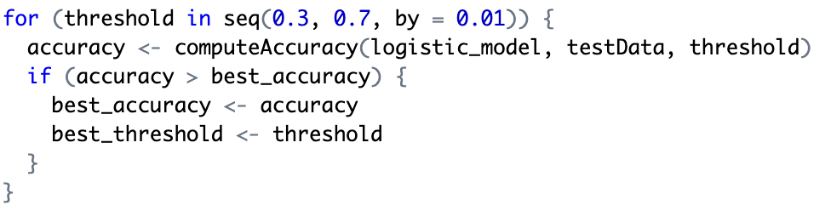
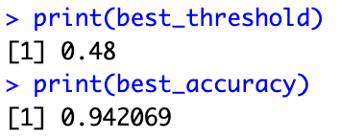
Model Training
Logistic Regression
Find the best threshold for the Logistic Regression Model

Slide 5
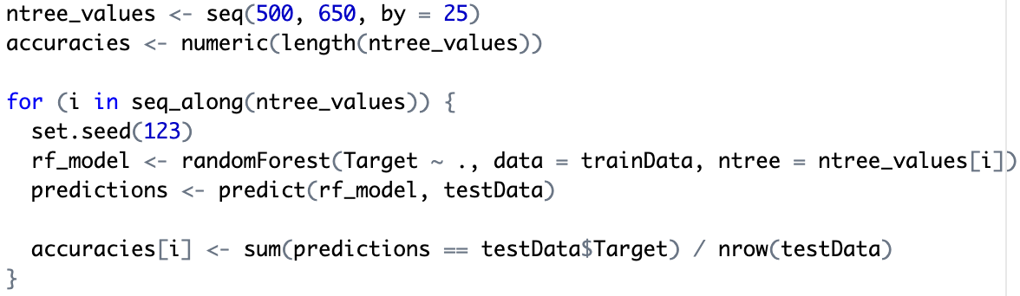
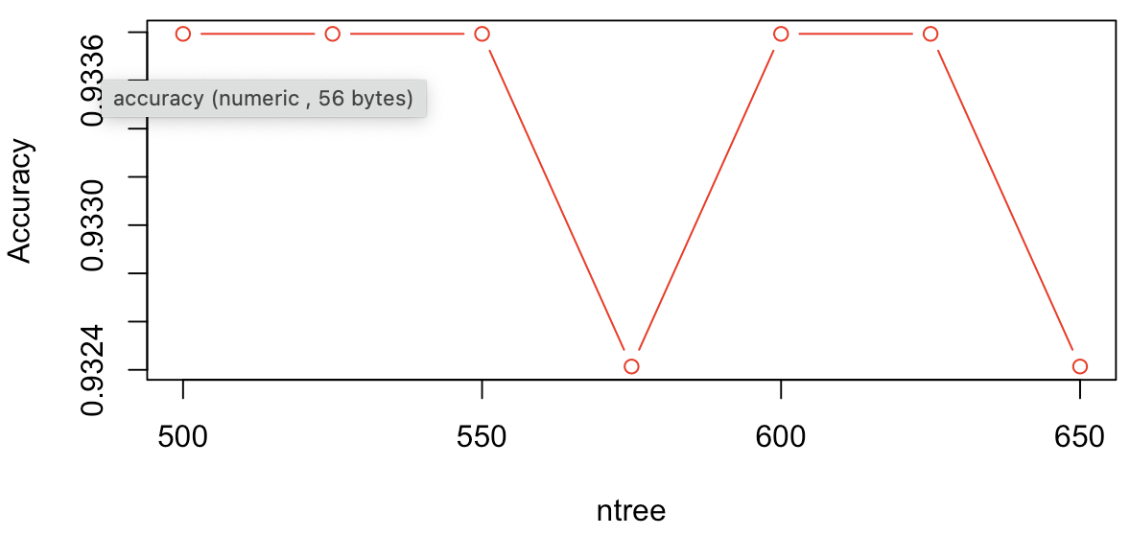
Model Training
Random Forest
Find the best ntree for the Logistic Regression Model

Slide 6
Model Training
Support Vector Machines (SVM)
Choose an appropriate kernel
accuracy = 0.9268966
accuracy = 0.942069

Slide 7
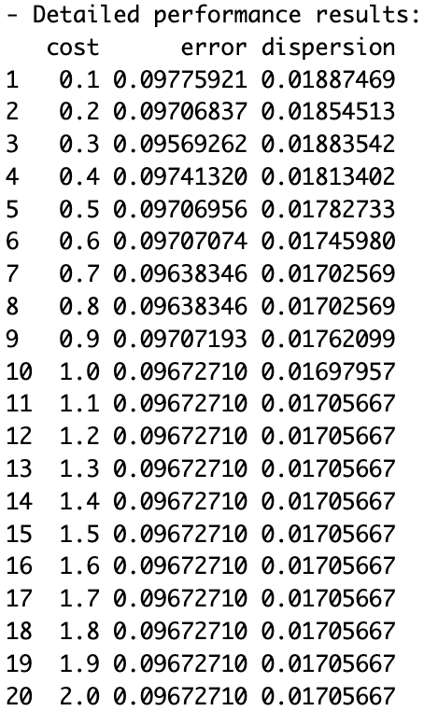
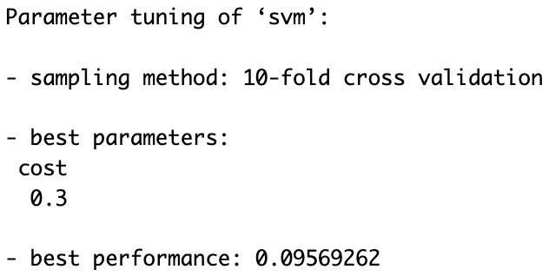
Model Training
Support Vector Machines (SVM)
Hyperparameter Tuning
Use cross-validation to find the optimal value of the cost parameter ‘C.’
accuracy = 0.946207

Slide 8
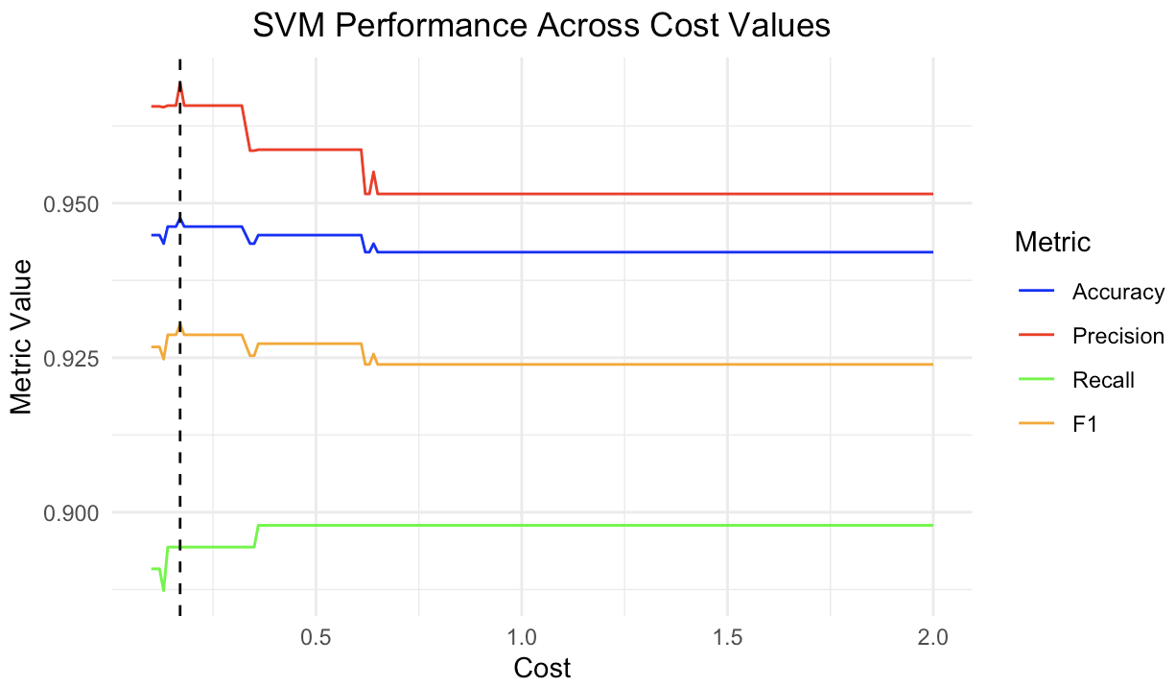
Model Training
Support Vector Machines (SVM)
Hyperparameter Tuning
Although the tune() gives 0.3 as the best cost, the accuracy performs best when the cost = 0.17.
accuracy = 0.947586
0.17

Slide 9
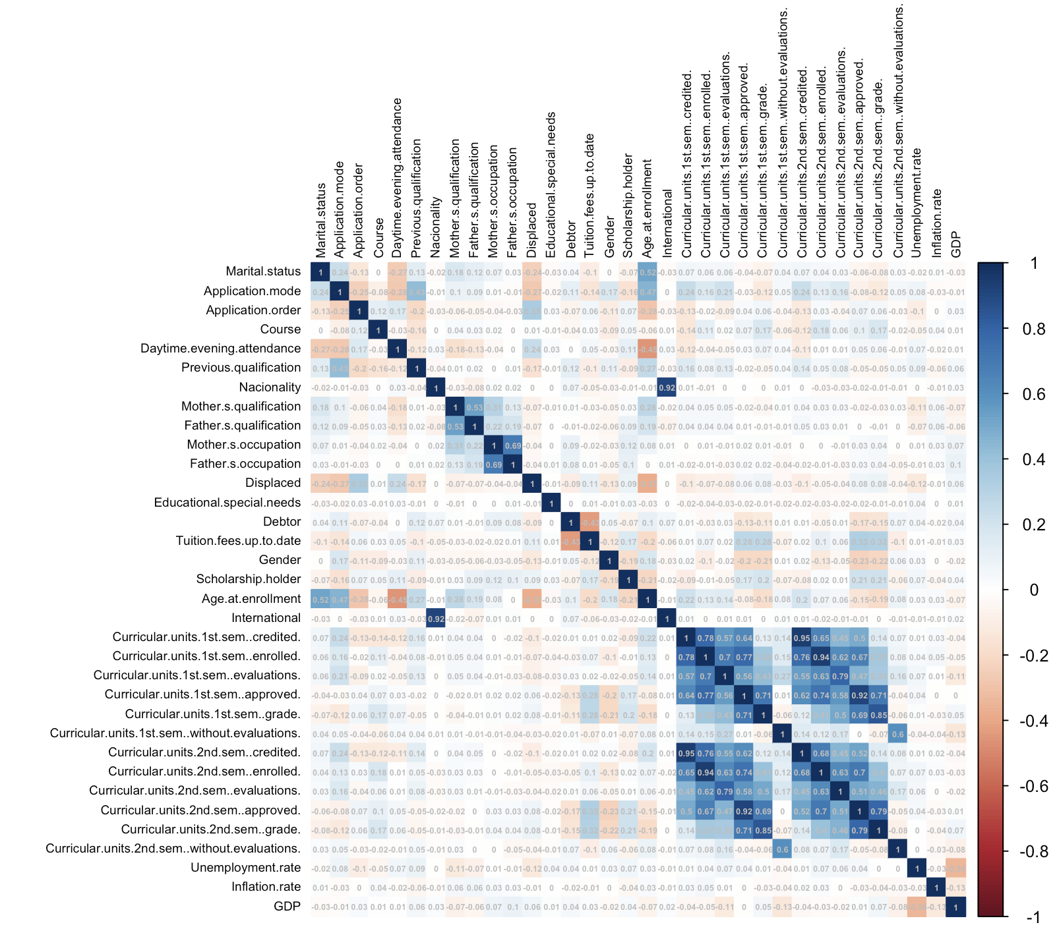
Model Training
Correlation Analysis
Identify pairs of features where the absolute value of the correlation is greater than 0.9 but less than 1.

Slide 10
SVM Model
Why the SVM Model performs better
Effectiveness in High-Dimensional Spaces: While the dataset has 34 features, SVM can handle high-dimensional data efficiently.
Margin Maximization for Clearer Class Separation: SVM can find the widest possible margin between classes, which benefits achieving a clear separation between 'Dropouts' and 'Graduates.’
Versatility Through Kernel Trick: The kernel trick allows SVM to handle both linearly and non-linearly separable data effectively.
Customization with Hyperparameter Tuning: The cost parameter and kernel coefficients can be customized to improve model performance.
Against Overfitting in High-Dimensional Space: SVM can be robust against overfitting while the number of features is smaller than the number of samples.

Slide 11
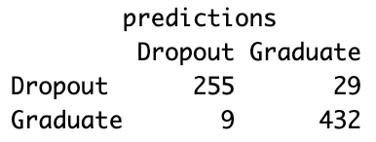
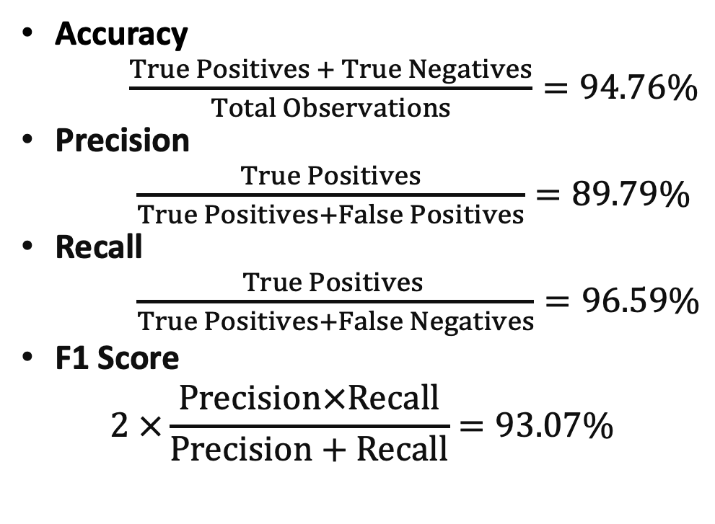
Model Evaluation
True Positives: Correctly predicted positive observations.
True Negatives: Correctly predicted negative observations.
False Positives: Incorrectly predicted positive observations (Type I error).
False Negatives: Incorrectly predicted negative observations (Type II error).
Notes:
The high accuracy means the model is generally reliable in its predictions.
The precision being lower than recall indicates the model has more false than false negatives.
The high recall means the model is quite good at identifying students who will graduate.
The F1 Score being close to 1 indicates a good balance between precision and recall, making it a robust metric for the model's performance, especially in cases where the cost of false negatives and false positives is different.

Slide 12

Model Deployment with SVM Model
Predict if enrolled students will drop out or graduate
Among 794 enrolled students, 316 may drop out, while the others may graduate
Educational institutes can help students who may drop out based on the prediction

